Slide 1

Hamming ECC
in
SSD RAID
Eliraz Kadosh
Eliram Amrusi
Supervisor: Dr. Amit Berman

Slide 2

Background
Over time, SSDs experience wear from repeated write/erase
cycles, leading to cell degradation and performance degradation
as error rates increase.
RAID 5 improves storage reliability by
recovering from single disk failures using parity.
Bit errors in SSDs are common and cannot be
corrected by RAID 5 alone.
Hamming ECC detects and corrects single-bit
errors using added parity bits.
Combining RAID 5 and Hamming ECC enhances
data integrity and system resilience.

Slide 3
Alternative Solutions
RAID 6: Uses double parity to recover from two simultaneous disk failures.
Offers better fault tolerance than RAID 5 but adds higher write complexity
and reduced performance.
Advanced ECC (BCH/LDPC): Corrects multiple-bit errors using polynomial
arithmetic over large data blocks, requiring complex hardware, more power,
and longer decoding time.

Slide 4
Chosen Solution
RAID 5 + Hamming ECC (12,8)
Combines disk failure recovery (RAID 5) with bit-level error correction.
RAID 5 handles single disk failures using XOR-based parity.
Improves data integrity, reduces read operations, and supports better
wear leveling.

Slide 5
Project Goals
Study the core of SSD structure.
Understanding error correction mechanisms and data redundancy in SSD
storage systems.
Designing and implementing a RAID 5 + Hamming ECC hardware system for
reliable data storage.
Performing a VLSI design flow including simulation, synthesis, and layout.
Design and implement a HW unit that enhances the lifetime of SSD-based RAID arrays.

Slide 6
The Algorithm
Architecture Design
Verification
Software Design
Synthesis & Layout

Slide 7
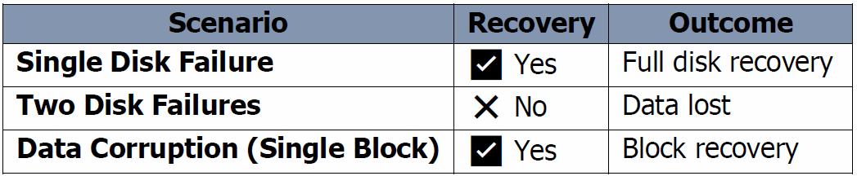
RAID 5 – Data Protection
RAID 5 uses XOR-based parity to recover
from a single disk failure.
For each write cycle, Parity = Data1 ⊕ Data2.
Data and parity blocks are distributed cyclically
across disks to balance wear.
In case of disk failure:
Missing Data Block = Data Block A ⊕ Data Block B.
Ensures efficient recovery with minimal overhead​.

Slide 8
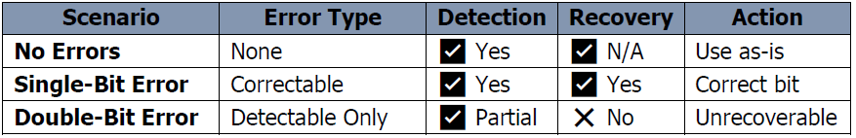
Hamming ECC (12,8)
Adds 4 parity bits to 8 data bits, forming a 12-bit codeword.
Can detect and correct single-bit errors within a block.
Bit positions: Parity bits at positions 1, 2, 4, 8; data bits fill remaining positions.
Parity bits calculated via XOR over selected data bits.
Decoding identifies error position via syndrome calculation.

Slide 9
System Logic
Data is encoded with Hamming ECC before being written to disks and the parity
block is calculated afterwards.
Read Process:
No errors found → Decode using Hamming.
If there is a single-bit-error → Fix by Hamming ECC and write it to memory.
Disk failure → Fix by RAID.
Write Optimization: Skip writing if data is unchanged, improves wear leveling.
This hybrid system enhances data reliability, reduces read load​.
 | Without RAID 5 and Hamming (12,8) | Hamming (12,8) only | RAID 5 only | RAID 5 + Hamming (12,8)
Overhead | 0% | 33% | 33% | 55.55%
Efficiency | 100% | 66% | 66% | 44.44%
Recovery Capability | No recovery capability | Single-bit error correction only | Single disk failure recovery | Single disk failure recovery + Single-bit error correction
Wear Leveling | Depends on system | Good | Good | Very good

Slide 10
Flow
Write Request Flow
Read Request Flow
RAID Recovery Flow

Slide 11
Software Design
Architecture Design
Verification
The Algorithm
Synthesis & Layout

Slide 12
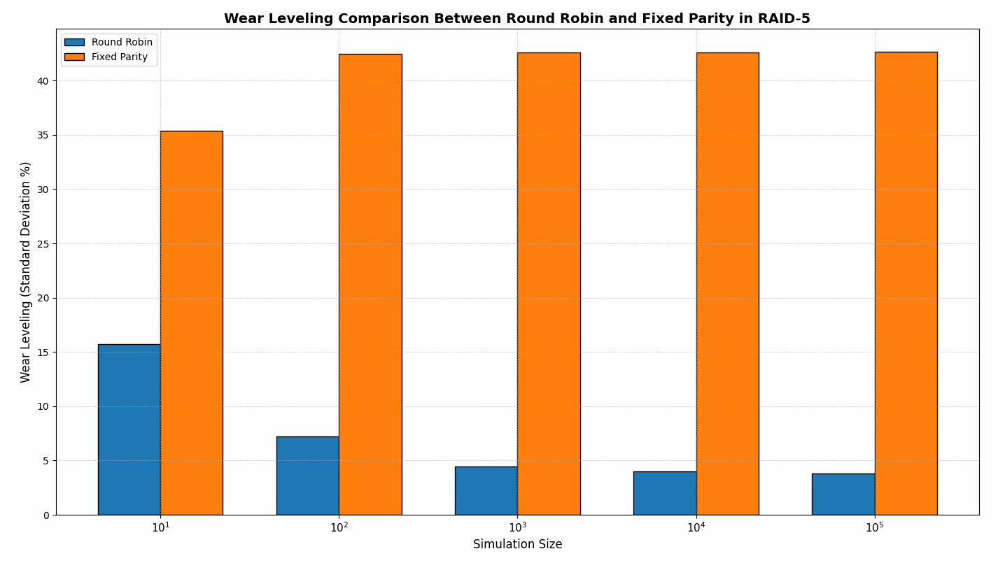
Proof of concept
A model of the algorithm was written in Python.
In a simulation of 100,000 writes, Round Robin parity showed an improvement of ~40% in wear leveling.
The RAID 5 + Hamming ECC logic was validated through software simulation.

Slide 13
Architecture Design
The Algorithm
Verification
Software Design
Synthesis & Layout

Slide 14
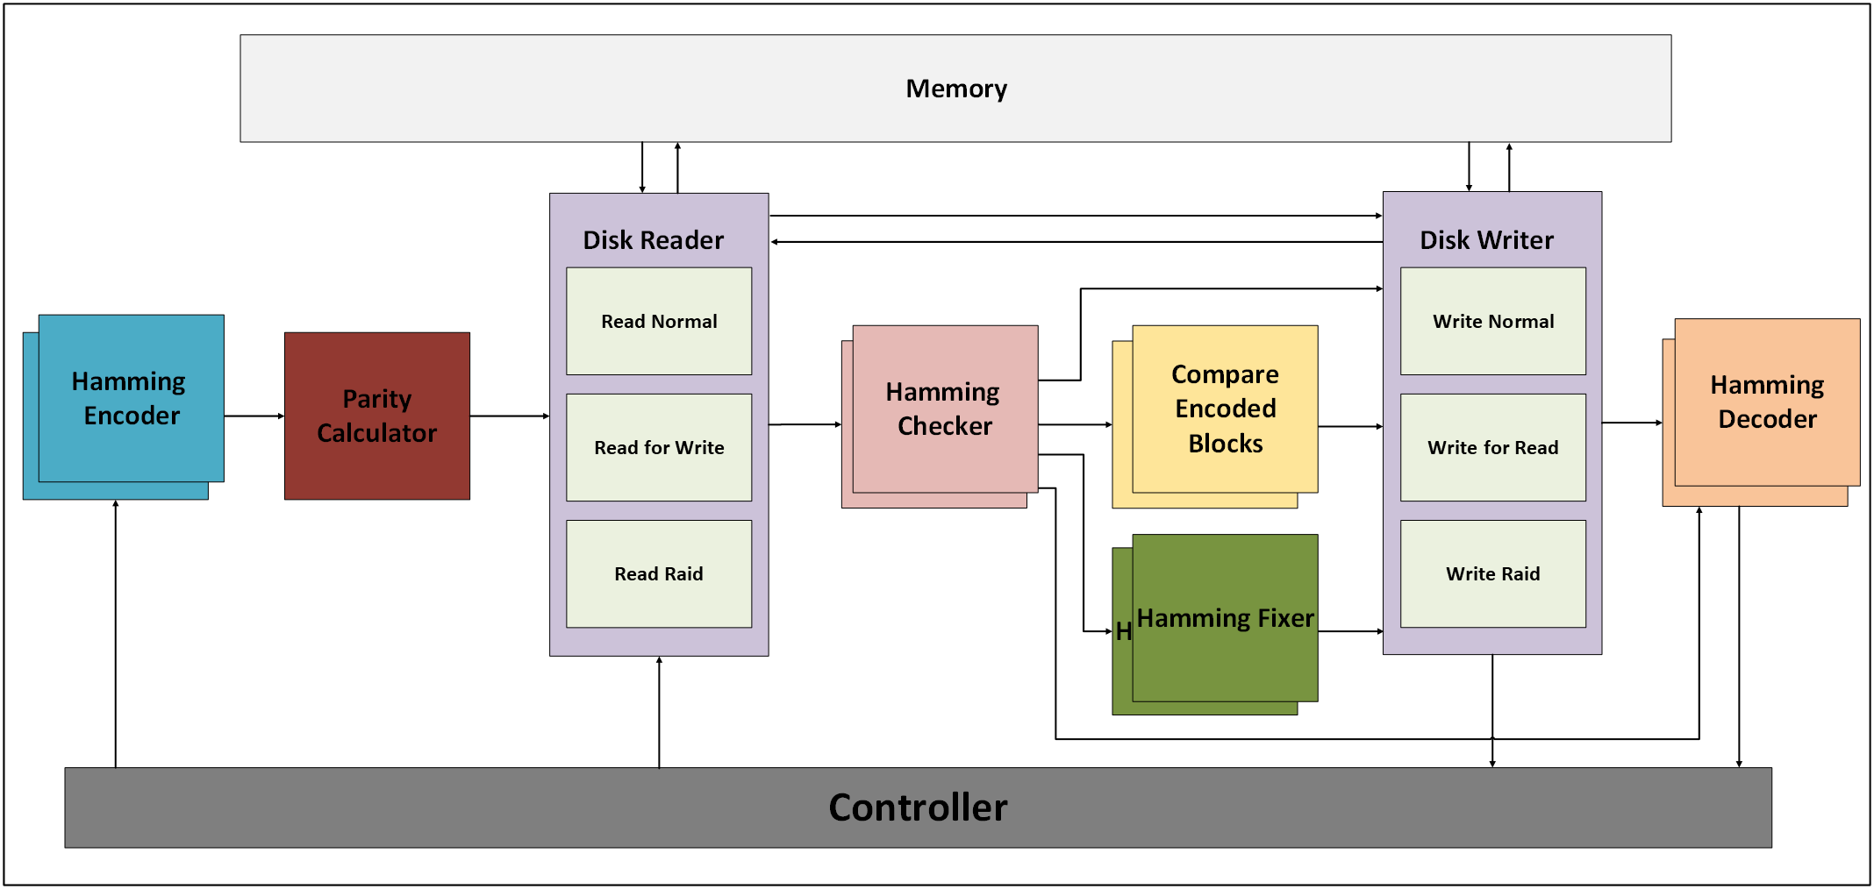
Architectural Design - Top Level
Inputs: • clk – System clock. • reset – System reset. • wr_enable – Write enable signal. • wr_data [15:0] – Data to be written. • address [7:0] – Address for read or write, depending on wr_enable or rd_enable. • rd_enable – Read enable signal. • disk_stat [2:0] – Indicates which disks are functional (used to simulate disk failure).
Output: • data_read [15:0] – Data that was read.

Slide 15
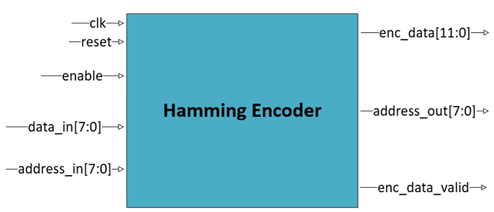
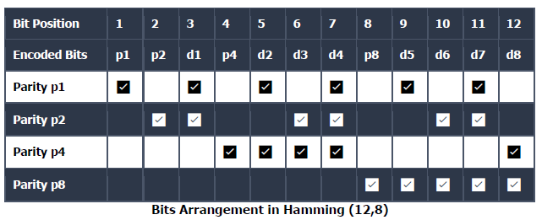
Hamming Encoder
Encodes 8-bit data into a 12-bit Hamming codeword using Hamming (12, 8).
Calculates 4 parity bits (P1, P2, P4, P8) using XOR logic over specific data bits.
Operates in a single clock cycle, outputting the calculated parity and passing through the data blocks.
2 such blocks for parallel computing.

Slide 16
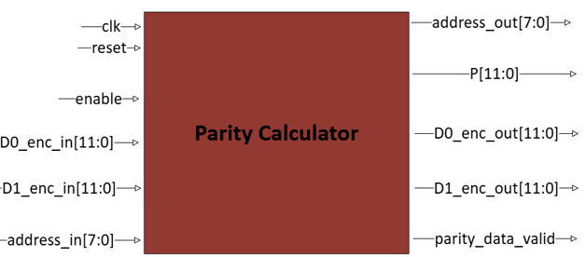
Parity Calculator
Computes the parity block (P) by performing bitwise XOR between two encoded data blocks (D0, D1).
Enables RAID 5 functionality, allowing data recovery in case of a single disk failure.
Ensures parity is aligned with Hamming-encoded data for consistency in error correction.
Operates in a single clock cycle, outputting the calculated parity and passing through the data blocks.

Slide 17
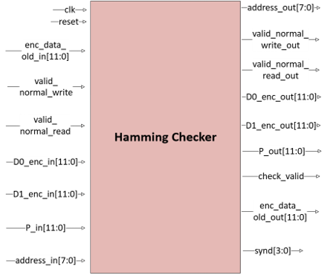
Hamming Checker
Checks a 12-bit Hamming-encoded block for single-bit errors (SBE) using syndrome calculation.
Calculates a 4-bit syndrome based on parity checks (P1, P2, P4, P8) to identify the error position.
If syndrome = 0: no error; if syndrome ≠ 0: error detected at the indicated bit position.
Prepares data for correction or validation and outputs results for read or write flows.
2 such blocks for parallel computing.

Slide 18
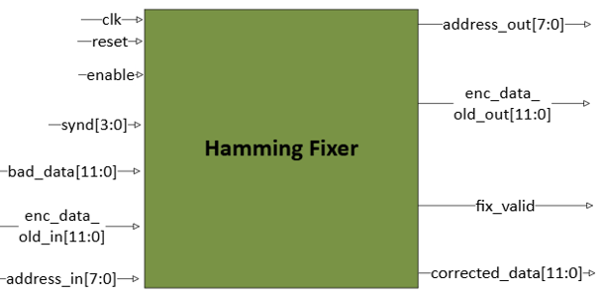
Hamming Fixer
Receives a syndrome (4 bits) indicating the position of a single-bit error within a 12-bit Hamming-encoded word.
A bitwise XOR between bad_data and the error_pattern corrects the error by flipping the faulty bit.
The corrected data is registered and outputted in the next clock cycle, along with the original encoded data and corresponding address.
2 such blocks for parallel computing.

Slide 19
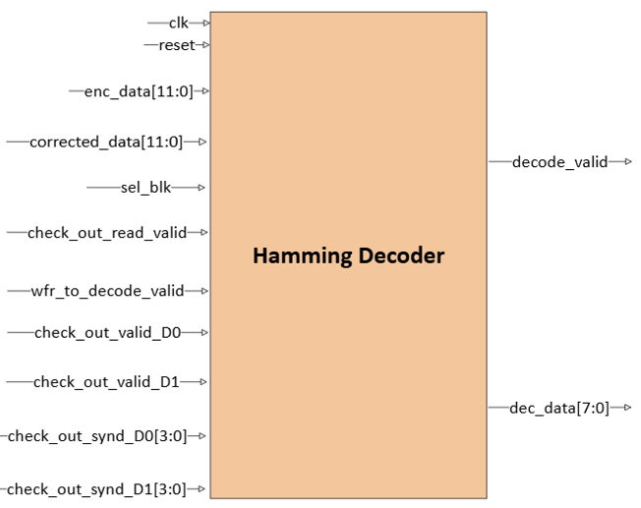
Hamming Decoder
Receives a 12-bit Hamming-encoded word and extracts the original 8-bit data.
Selects between the corrected data (from Hamming Fixer) and the original encoded data, based on control signals.
Outputs only the data bits, ignoring the parity bits, from predefined positions.
2 such blocks for parallel computing.

Slide 20
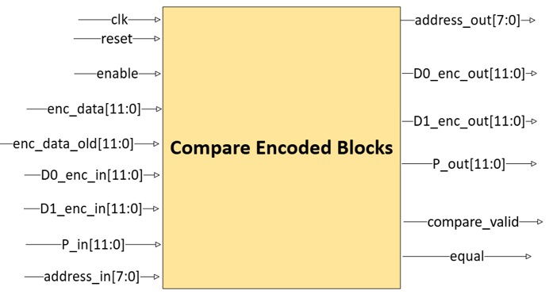
Compare Encoded Blocks
Compares two 12-bit Hamming-encoded blocks to determine if they are identical.
Helps avoid unnecessary writes to memory by detecting if new data equals existing data.
Reduces write cycles, improving wear leveling and overall system efficiency.
Outputs a flag (equal) indicating whether the blocks match.
2 such blocks for parallel computing.

Slide 21
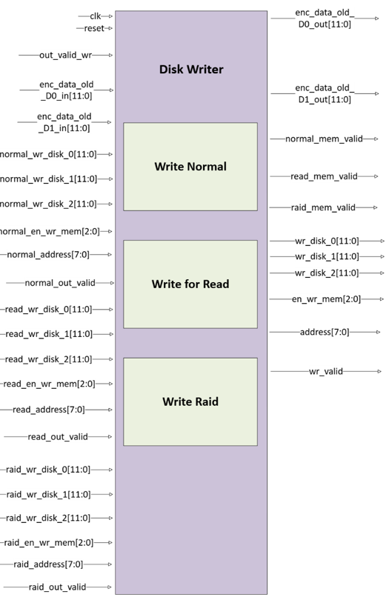
Disk Writer
Acts as a multiplexer, selecting between three write paths:
Normal Write, Write for Read, and RAID Recovery Write.
Manages data routing and control signals for writing to SSD disks.
Ensures that only necessary data is written, reducing wear and improving efficiency.
Signals back to the controller when the write operation is completed.

Slide 22
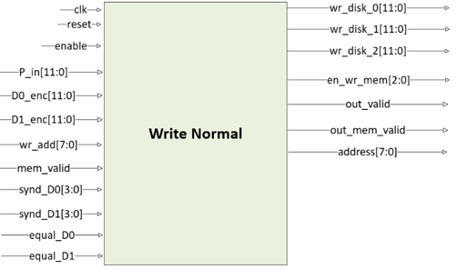
Write Normal
Handles standard data writes to disks using Hamming-encoded blocks and calculated parity.
Determines which blocks (D0, D1, P) need to be written based on:
• Syndrome results (error detection)
• Comparison results (data changed or not)
Avoids writing blocks that are unchanged, reducing unnecessary writes.
Ensures efficient and balanced wear leveling across disks.

Slide 23
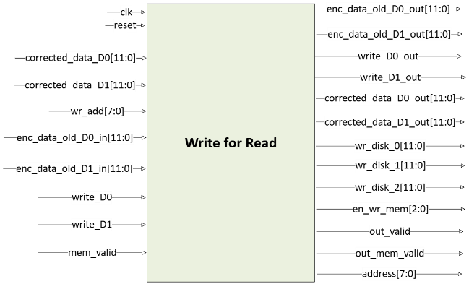
Write for Read
Activated when a single-bit error is detected and corrected using Hamming ECC.
The corrected data block is written back to memory to restore data integrity.
Ensures that future reads will access the error-free version of the data.
Only the corrected block is written — no parity recalculation is performed.

Slide 24
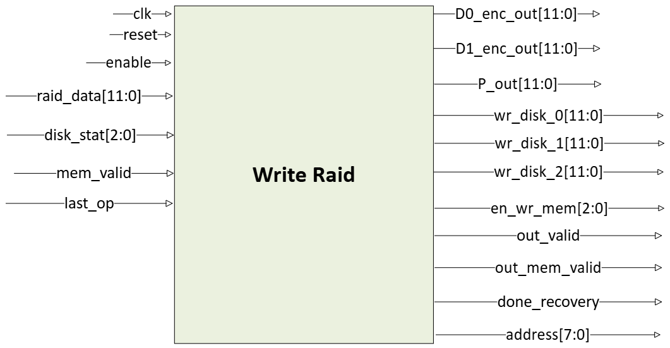
Write Raid
Triggered during RAID 5 recovery when a disk failure is detected.
The missing block is reconstructed using the XOR of the two remaining blocks.
The recovered data is then written to the location of the failed disk once it becomes available.
This mechanism ensures full data restoration after a single disk failure

Slide 25
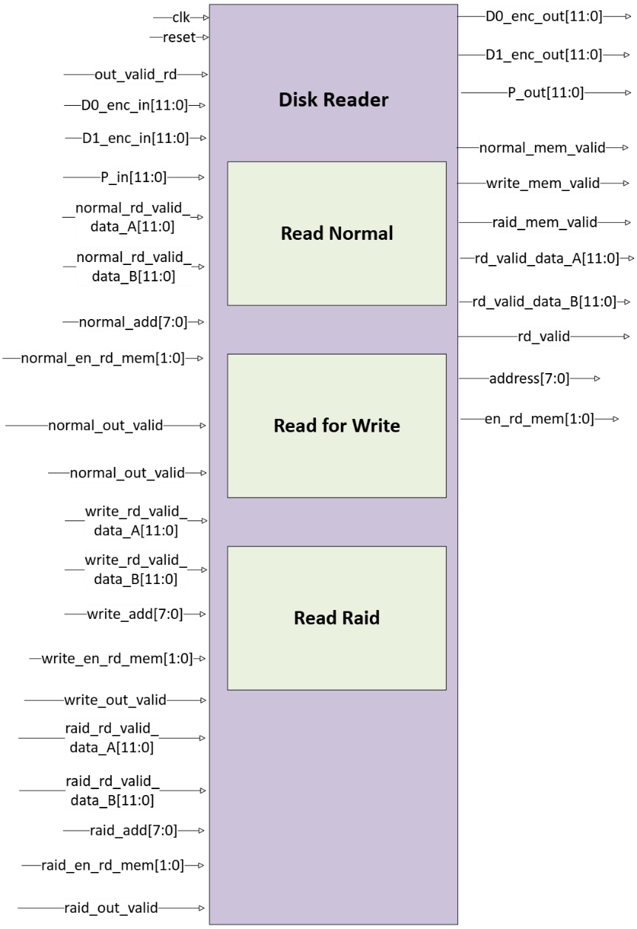
Disk Reader
Reads data blocks (D0, D1, P) from the SSD disks based on the input address.
Operates in both normal read and RAID recovery modes.
Handles reading from two functional disks when a third has failed (based on disk_stat).
Synchronizes data and control signals to the next processing blocks (e.g., Hamming Checker or RAID Recovery).

Slide 26
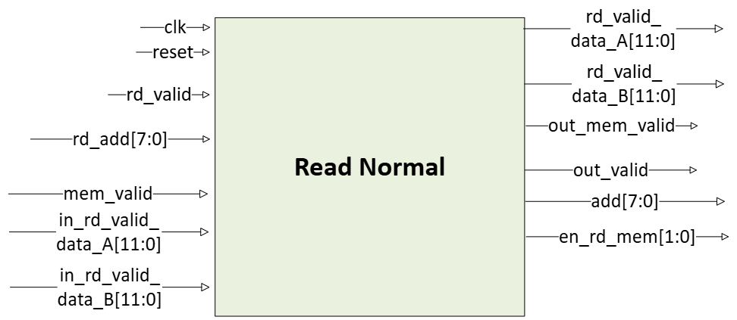
Read Normal
Activated during a standard read operation when no disk failures are present.
Only the data blocks (D0, D1) are read from memory.
Each block is passed through the Hamming Checker to detect possible bit errors.
If an error is found, the block is sent to the Hamming Fixer for correction.
After correction (if needed), the selected block is decoded and sent to the output.

Slide 27
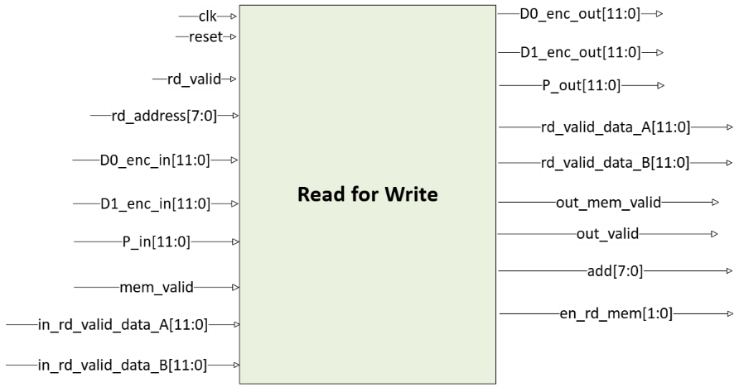
Read for Write
Used before a write operation to reduce unnecessary writes in case of unchanged data.
Reads the existing encoded blocks (D0, D1) from memory.
The current data is used to calculate the new parity, based on the incoming data.
This step preserves data consistency and parity integrity.

Slide 28
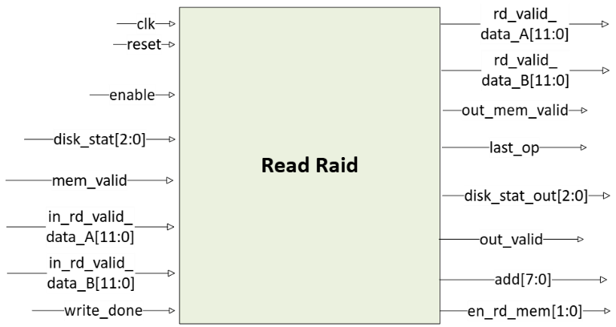
Read Raid
Activated when a disk failure is detected (disk_stat indicates one faulty disk).
Reads the two available blocks from the functioning disks.
Uses XOR logic to reconstruct the missing block.
The recovered block is then passed through Hamming Checker to detect and correct possible bit errors.
Ensures correct data output even in the presence of a single disk failure.

Slide 29
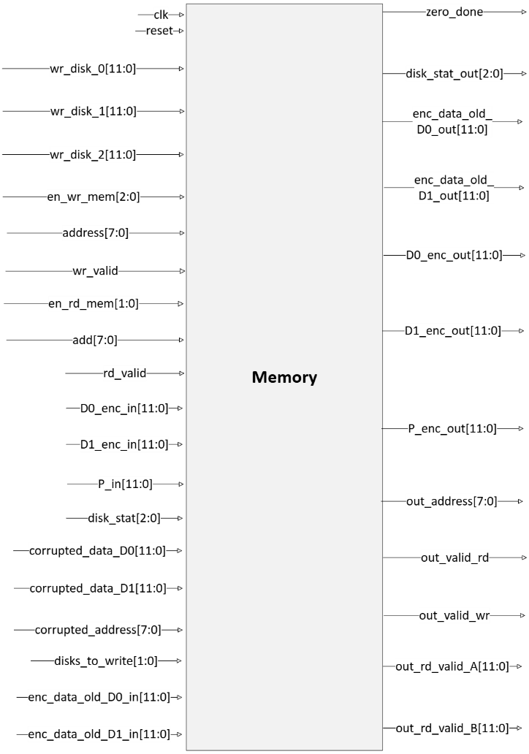
Memory
Implements three separate memory blocks to represent the three RAID 5 disks: Disk 0, Disk 1, and Parity Disk.
Each memory stores 12-bit Hamming-encoded blocks.
Supports read and write operations controlled by enable and address signals.
Works in all modes: Normal Write/Read, Read for Write, Write for Read and RAID Recovery.
Facilitates realistic simulation of disk behavior, including disk failure emulation via disk_stat.

Slide 30
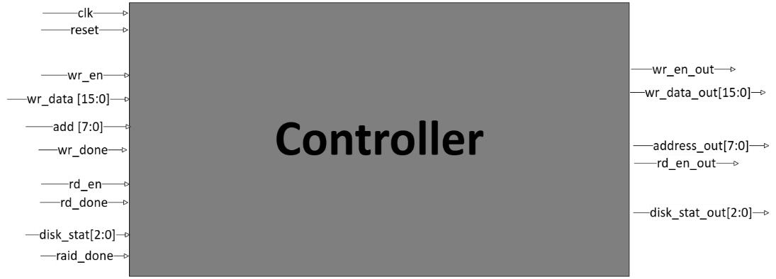
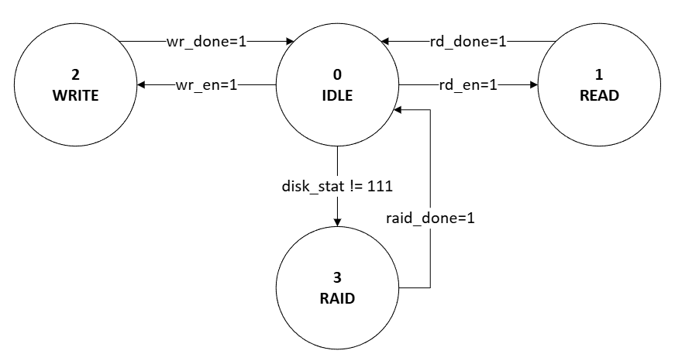
Controller
Manages the overall system flow, coordinating between all functional blocks.
Operates as a finite state machine (FSM) with defined states: WRITE, READ, and RAID.
Controls data flow, addressing, and enable signals across the system.
Ensures smooth integration of RAID 5 logic with Hamming-based error correction.

Slide 31
Verification
The Algorithm
Architecture Design
Software Design
Synthesis & Layout

Slide 32
Verification
The simulation aimed to emulate a realistic work environment, test the component’s functionality, verify output correctness, and evaluate the HW unit’s efficiency.
Simulation Process:
• First, a testbench was written for each module individually to ensure correct functionality.
• Then, a dedicated testbench was developed for the full system integration.
• During verification, each module was added step-by-step to the simulation chain. After verifying each partial integration, the next module was included.
• This incremental testing approach ensured correct operation of both individual blocks and the complete system.

Slide 33
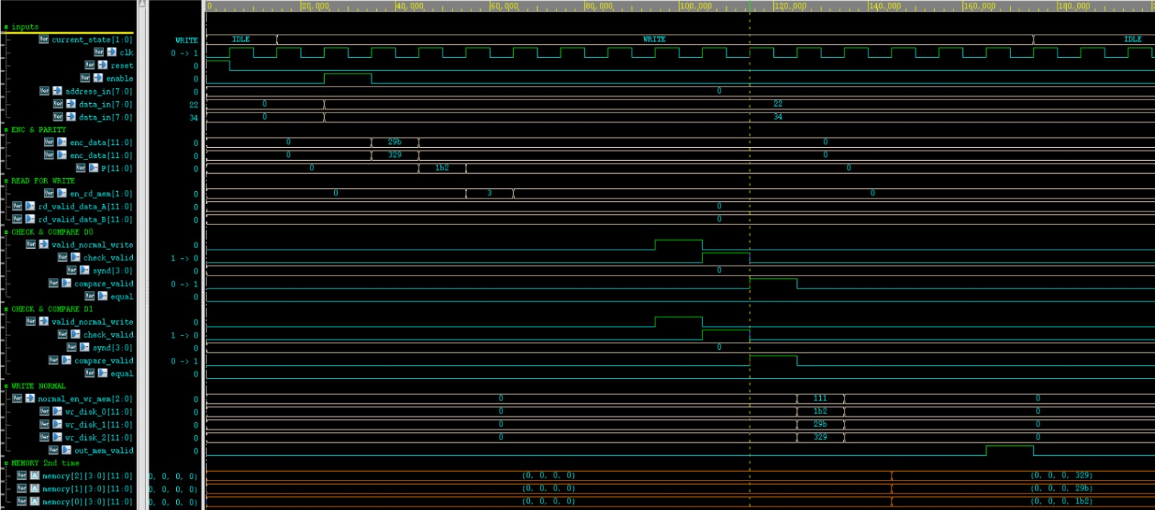
Simulation 1: Normal Write
Objective: Test a full normal write flow to memory without any errors in the data blocks.
Hamming Encoding applied to data blocks: D0: 0x22 (b 0010 0010) → 0x29B (b 0010 1001 1011) D1: 0x34 (b 0011 0100) → 0x329 (b 0011 0010 1001)
Parity Block Calculation (XOR of encoded blocks): P = XOR(0x29B, 0x329) = 0x1B2 = XOR(b 0010 1001 1011 , b 0011 0010 1001) = 0x1b2 (b 0001 1011 0010)

Slide 34
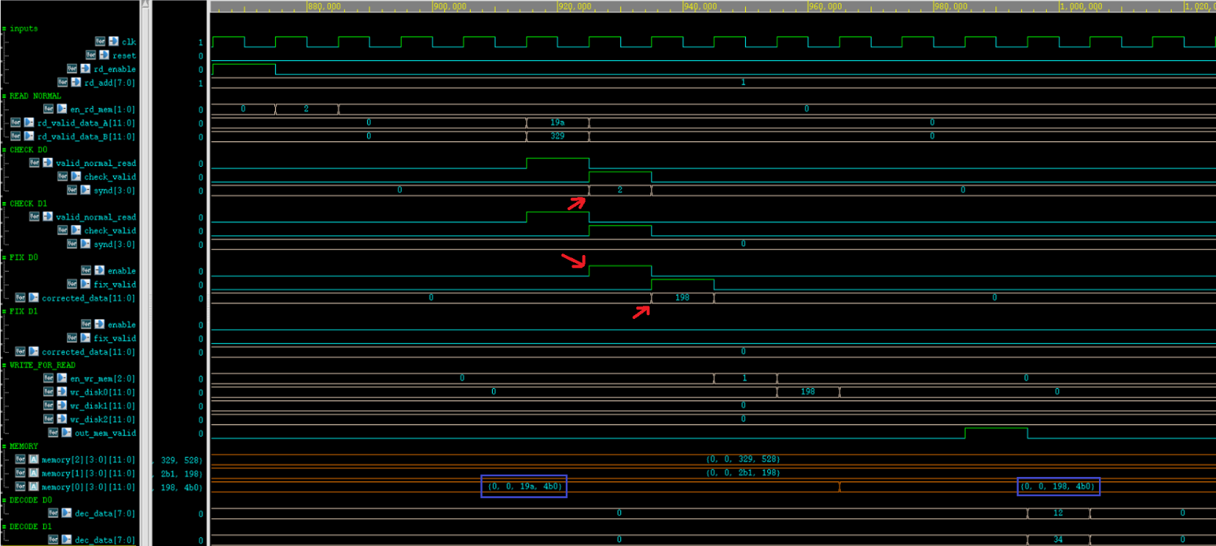
Simulation 2: Normal Read
Objective: Test a normal read operation where block D0 contains a single-bit error.
A single-bit error was introduced in bit #2 of D0 -> Hamming Checker detected the error -> Hamming Fixer corrected it by flipping the erroneous bit from 1 to 0: 0x19A (b 0001 1001 1010) → corrected to 0x198 (b 0001 1001 1000)
The final decoded output was correct: 0x1234

Slide 35
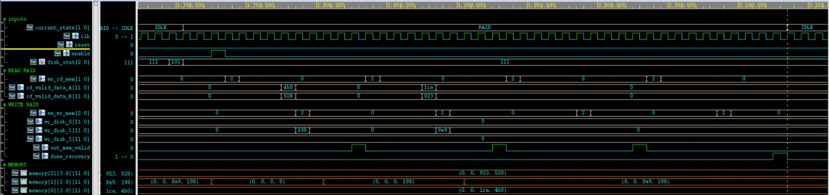
Simulation 3: Disk Failure + RAID Recovery
Objective: Simulate a disk failure followed by RAID 5 data recovery.
The signal disk_stat = 101 indicates that Disk 2 has failed. To simulate the failure, all blocks in Disk 2 were set to zero.
One clock cycle later, we simulated a disk replacement with a new (empty) disk.
The FSM transitioned to the "RAID" state, initiating data reconstruction.
The recovered data was written to the new disk.
Memory content after recovery was identical to the content before the failure, confirming a successful RAID recovery.

Slide 36
Synthesis & Layout
The Algorithm
Architecture Design
Software Design
Verification

Slide 37

Synthesis
The circuit was synthesized using Synopsys Design Vision.
This stage translated the RTL (Verilog) code into
a gate-level netlist.
The tool provided reports for key metrics:
Timing (performance and critical path delays)
Area (cell usage and gate count)
Power (dynamic and leakage consumption)
These results helped evaluate the design's hardware
efficiency and guide possible optimizations.

Slide 38
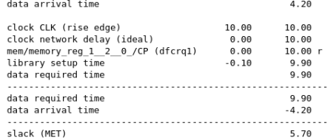
Timing
The tool identified the critical path and calculated the
maximum clock frequency.
The design achieved a clock period of 9.90 ns,
corresponding to a frequency of 101.01 MHz.
Timing was met with no setup or hold violations,
ensuring stable and reliable operation at the target
frequency.

Slide 39
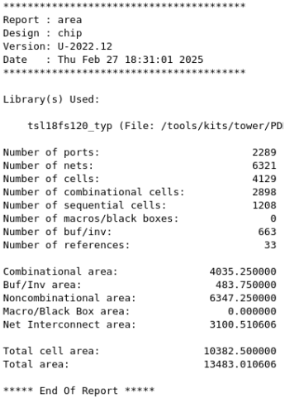
Area
Total cell area: 10,382
Routing area: 3,100
Total area: 13,483
Note: The area is reported in NAND2 gate equivalents, which is a standard unit used to
estimate circuit complexity and compare designs independently of physical layout size.

Slide 40
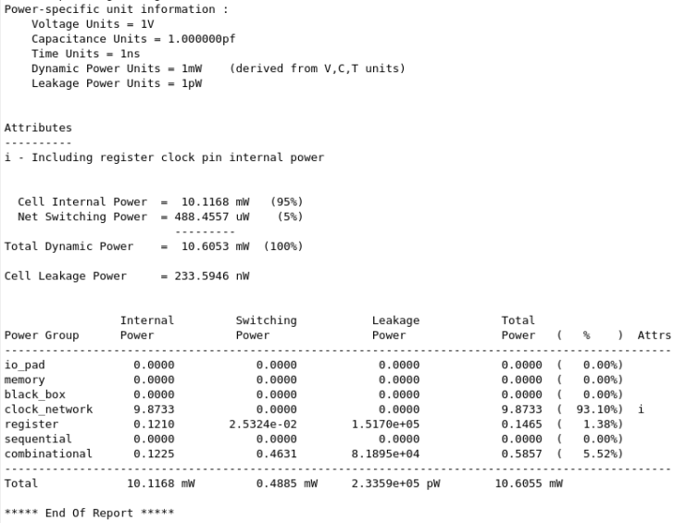
Power
• Dynamic Power: 10.60 [mW] • Static Power: 233.59 [nW]

Slide 41
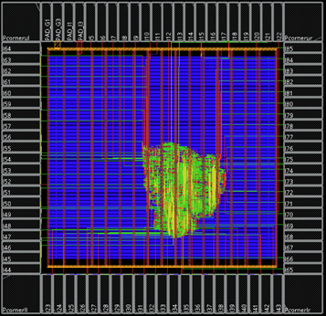
Layout
After synthesis, the physical layout was created using
the Innovus tool by Cadence.
The layout was implemented using Tower
Semiconductor’s 0.18μm CMOS technology.
Area of the HW unit: 2006 × 2072 [μm²]

Slide 42
Summary & Conclusions
The project began with a literature review on Error Correction Codes and RAID
Accelerators for Solid-State Drives (SSDs).
A software model of a RAID 5 + Hamming ECC system was implemented and verified in Python.
The hardware architecture was designed and described using SystemVerilog.
Each block was tested independently, followed by full system-level simulations.
The design was synthesized using Synopsys Design Vision.
A full layout was created using Cadence Innovus in 0.18μm CMOS technology.
Throughout the project, we gained experience in hardware design flow from concept to
layout and validation.

Slide 43




